Slide 1

Kuali Workflow

Slide 2

Workflow Concepts
Document Header
Workflow/Route Status
Route Nodes/Levels
Branches
Action Requests
Delegation
Searchable Attributes

Slide 3
Route Statuses
In the general order they will happen:
  INITIATED (I)
  SAVED (S)
  ENROUTE (R)
  APPROVED (A)
    After all approval action requests have been acted upon.
    fairly transient state - users won’t see this
  PROCESSED (P)
    after final processing has happened as a result of the document being fully approved
  FINAL (F)
    after all action requests have acted upon (ACK/FYI)
Plus, a few additional:
  CANCELED (X)
  EXCEPTION (E)
  DISAPPROVED (D)
  DISAPPROVED-CANCEL (C)

Slide 4
Route Levels
These can be custom to each document.
There are no standard route levels except “AdHoc”
Examples:
  OrganizationReview
  TaxManager
  Account (fiscal officer)
Users/Groups with a responsibility at this level will have action requests generated for them. (resulting it being placed in their inbox)
Routing at a level can be made either parallel or serial.
All approvals at a given level must be completed before the document will continue to the next level.

Slide 5
Action Requests
Created by KEW based on the responsibilities associated with a given route node/level.
Will have a type:
  APPROVE (A)
  ACKNOWLEDGE (K)
  FYI (F)
  COMPLETE (C) - (only for non-submitted documents)
Has a status:
  INITIALIZED (I) - request has been created but is not in effect
  ACTIVE (A) - request has been activated and is in someone’s inbox
  DONE (D) - request has been acted upon and an ActionTaken object has been created (and appropriate processing completed)

Slide 6
Action Request Graphs
Action Requests form a hierarchy of nodes
The hierarchy determines how they are processed in terms of parallel routing and delegations.
A single top-level node is created for each required action. If multiple people can satisfy that action request, they are listed as children under the master node.

Slide 7

Actions Taken
These are the audit trail of actions taken on the document.
  For Example:
    SAVED
    COMPLETED
    ROUTED
    APPROVED
    etc…

Slide 8
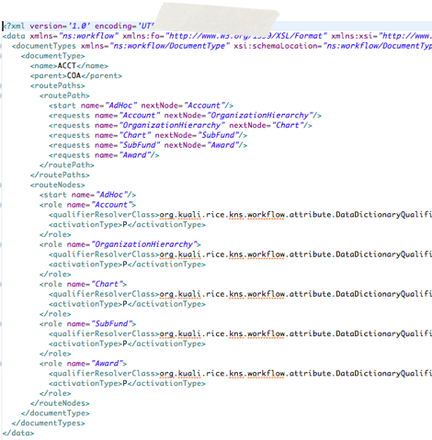
How KIM Fits In
Route levels are created with an implementation class.
This class (now integrated into the KEW XML parsing) indicates how the level’s members should be resolved:

Slide 9
KIM Responsibilities
Responsibility Template
  Only 2 kinds used by workflow:
    Review
    Resolve Exception
Responsibility
  Has a template (one of the above)
  and detail attributes:
    documentTypeName
    routeNodeName
    required
    actionDetailsAtRoleMemberLevel

Slide 10
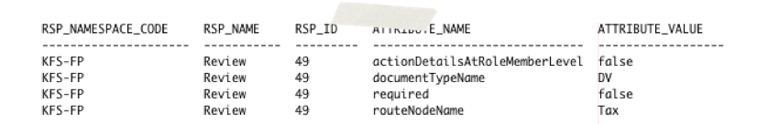
Example Responsibility Data

Slide 11
Responsibility Action
For each responsibility associated with a route level, there must be an associated action.
This defines what a user must do to satisfy the request.
It also determines how many people must satisfy the request.
Attributes:
  role member ID
  action type (A/K/F)
  Priority
  Policy (First/All)
  Force Action

Slide 12
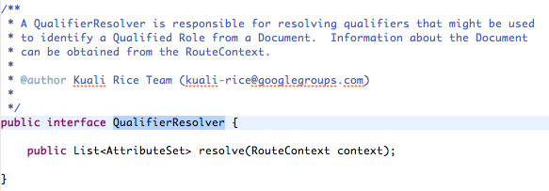
Qualifier Resolver
Extracts data out of the document to expose to the workflow engine.
In this case, for the purposes of determining who has responsibility at this stage of routing.

Slide 13
Data Dictionary Qualifier Resolver
Currently only in KFS
Should be moved to Rice
Uses DD information in order to configure the resolver without writing code.
Uses property paths and exposes them with specified names to the workflow engine.
Multiple sets of qualifiers can be returned.
  E.g., So multiple accounts and/or orgs can be returned.

Slide 14
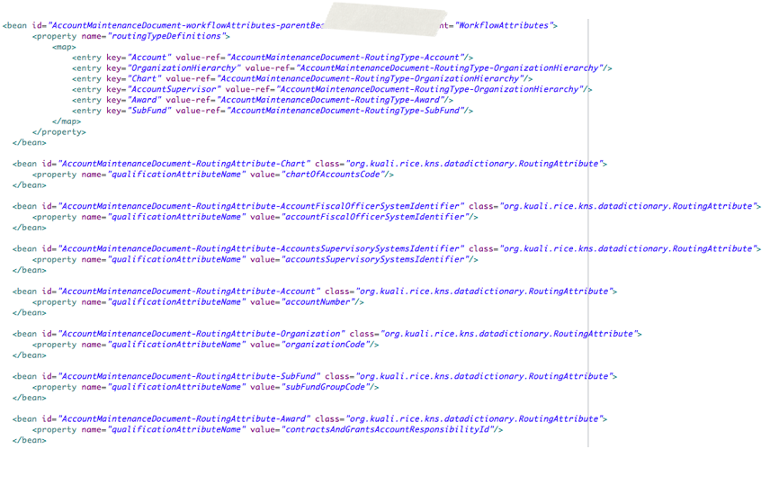
Example DDQR Configuration (1)

Slide 15
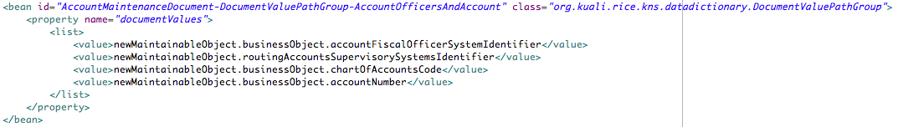
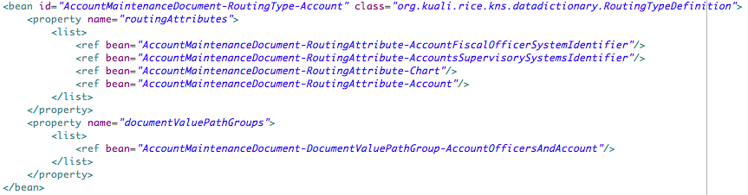
Example DDQR Configuration (2)

Slide 16
Responsibility Resolution Logic
This is all handled by the ResponsibilityService
KEW passes in the current document type name and route level.
Additionally, KEW calls the QualifierResolver for the route level to pull appropriate information out of the document.
KEW checks KIM for each set of qualifiers returned by the resolver.

Slide 17
KIM Responsibility Resolution Logic
Given the responsibility template namespace and name, pull all matching responsibilities.
Pare down the list to just those which match the given document and route level.
  Route level must match exactly.
  The document hierarchy will be considered. The most specific (lowest-level) responsibility will be used.
Find the roles which have the given set of responsibilities.
Find the members of those roles.

Slide 18
KIM Responsibility Resolution Logic (2)
With the role members, compare the qualifier generated from the document data.
  This reduces the list to just those who would have the role given the data on the document.
Check for any delegations associated with the selected role members. Resolve those users and add to data.
Now, with the final set of users/groups/roles with this responsibility, pull in the actions that each need to perform.
Perform any final resolution of roles to users and groups.

Slide 19
Responsibility Action Handling in KEW
Workflow takes the ResponsibilityActionInfo objects returned from KIM and converts them into ActionRequestValue objects.
  ActionRequestFactory performs the work of building the graph.
  These objects MUST be returned in the order they should be activated.
RoleNode handles activating the appropriate requests.
  Looks at the activation type (parallel/serial)
  Looks at priority
  Looks at any custom grouping of the requests

Slide 20
Responsibility Type Services
Resolving of Responsibility Details
  Implementation only returns the most specific responsibility that applies. This assumes that it overrides higher level responsibilities.
  See: ReviewResponsibilityTypeServiceImpl

Slide 21
Role Type Services
Resolving of Role Qualifiers
  Implemented by client systems in many cases. This allows the service access to system-specific information. (E.g., organization hierarchy)
Sorting of role members before returning.
  Not necessary unless important for routing.
    E.g., for organization hierarchy routing, lower level organizations are returned first so they get the document first.
Grouping of role members for parallel routing
  Set on RoleMembershipInfo objects during sort method
  Used during parallel routing to only activate one org at a time
  See: OrganizationHierarchyAwareRoleTypeServiceBase in KFS

Slide 22
Handling Workflow Events
KualiPostProcessor
  Can use standard version from Rice
  Calls into the document
Route Status Changes
  Most common hook
  Usually checking for when document moves into APPROVED (A) status
Route Level Changes
  If custom processing is needed in the middle of routing

